Slide 1



Learn. Imagine. Build. .NET Conf
Xamarin – Building cross-platform apps
Tsvyatko Konov

Slide 2



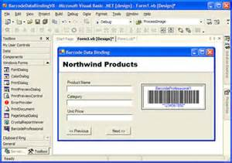






About me
2005
2009
2014-Today

Slide 3
Prehistory of Xamarin
2001 – Miguel de Icaza founded Mono OS project
2011 - The engineers behind mono, monotouch and mono for android founded Xamarin (mono foundation granted licenses to use the technology)
On February 2016 Microsoft acquire Xamarin
Notes:
Ximian Acquisitions by Novel at 2003, Attachmate 2011 – then layoffs of mono engineers.
Evolve 2016 brought Steve Wozniak on stage

Slide 4

Microsoft + Xamarin
Microsoft core strategy – cloud-first mobile-first
Strong offering of Azure Services
Xamarin fills the gab in MS mobile offering
Notes:
Ximian Acquisitions by Novel at 2003, Attachmate 2011 – then layoffs of mono engineers.
Evolve 2016 brought Steve Wozniak on stage

Slide 5
.NET Standard and Xamarin brings it all together
Xamarin Forms
CLOUD MICROSERVICES
GAMES / 3D
IOS,ANDROID
WINDOWS 10
TRADITIONAL WINDOWS
OSX
LINUX
.NET STANDARD
LIBRARIES
INFRASTRUCTURE
COMPILERS
LANGUAGES
RUNTIME COMPONENTS
Notes:
When we talk about .NET we’re talking about an entire unified platform and ecosystem. Any workload on .NET supports .NET Standard going forward. With Mono now under the .NET Foundation we can steer the direction of all of these implementations more easily. Each .NET implementation be that .NET Framework, .NET Core, or Mono for Xamarin & Unity, share the same common infrastructure and .NET Standard library. This means not only are your .NET skills portable, but your actual binaries are portable across implementations.
You can think of the .NET Standard to HTML5 – it’s a specification of HTML that browsers must implement. Similarly, the .NET Standard defines the API’s that all the .NET’s must implement. This is the promise of .NET Everywhere.
See: https://docs.microsoft.com/en-us/dotnet/articles/standard/components

Slide 6
Xamarin Forms – one abstraction for the UI
C# Bindings helps platform specific UI directly in .NET
Xamarin Forms unify the UI into one API
IOS
Android
UWP
Tizen (preview)
OSX (preview)
Linux (preview)
WPF (ieventually)

Slide 7
Xamarin.Forms - capabilities
40+ Pages, Layouts, and Controls
XAML and C#
Two-way Data Binding
Navigation
Animation API
Dependency Service
Messaging Center
.NET Standard compliant (starting with 2.4.0)

Slide 8
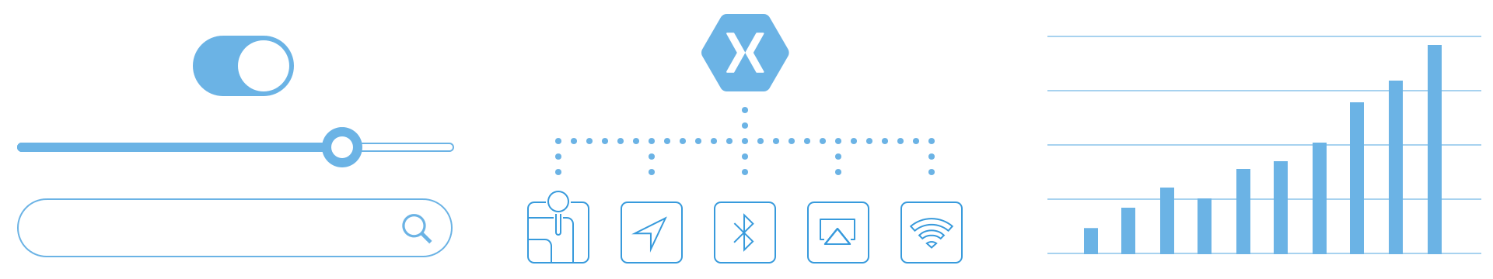
What gives you Xamarin
Native User Interfaces
Native API Access
Native Performance
Xamarin apps look and feel native because they are native

Slide 9
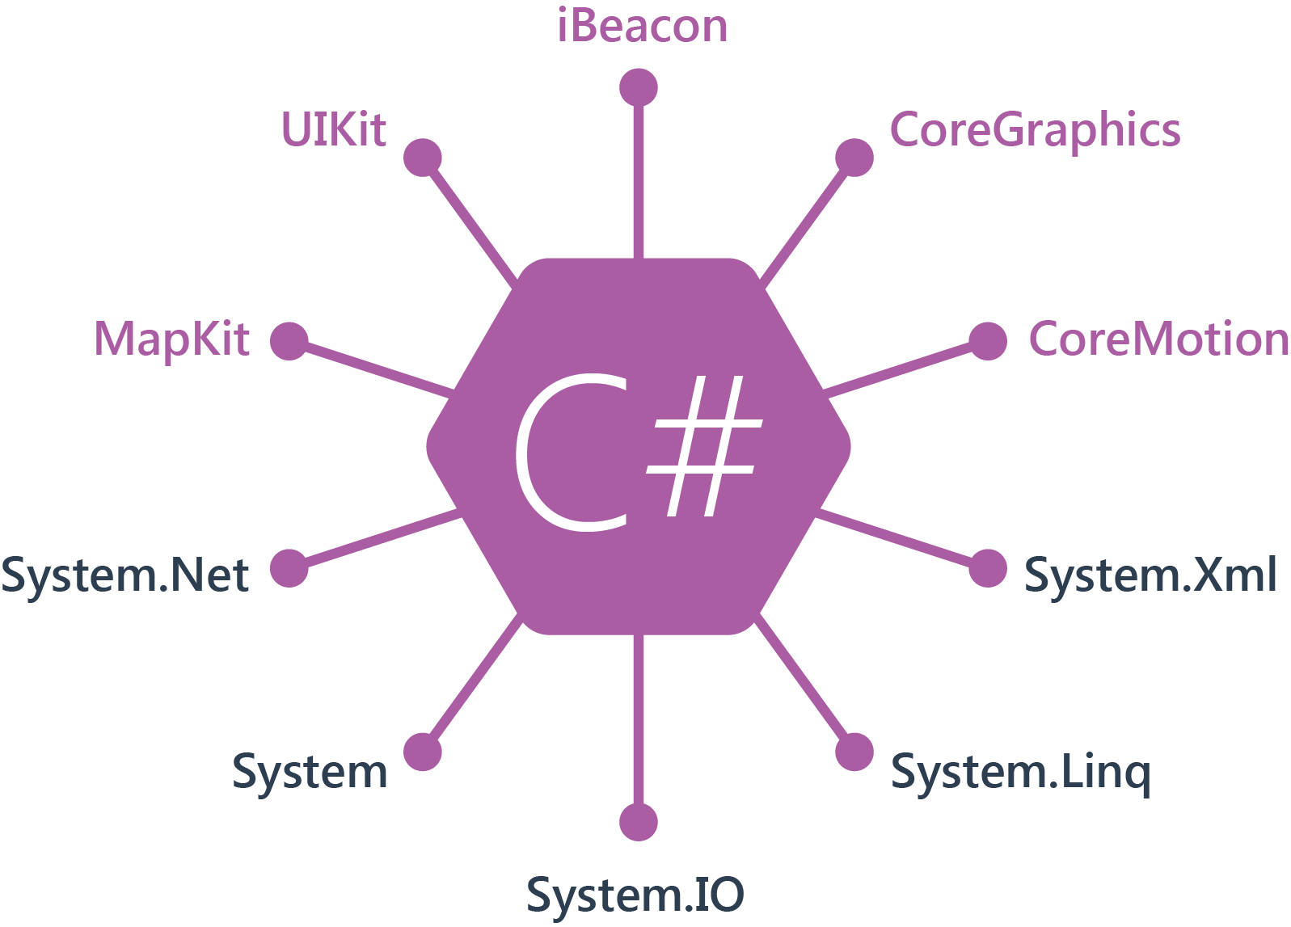
Xamarin for IOS
Initially based on monothouch
Uses AOT compilation
Sgen Garbage collector for C# objects
Notes:
Monotouch keeps its references with retains for automatic disposing from the auto refcounting

Slide 10
iOS
@implementation MSViewController
- (void)viewDidLoad
{
[super viewDidLoad];
}
- (IBAction)OnButtonDown:(id)sender {
UIAlertView* view =
[[UIAlertView alloc]init];
[view setTitle:@"Hello World"];
[view setMessage: @"How are you?”];
[view addButtonWithTitle:@"OK"];
[view show];
}
@end
public partial class iOSAppViewController : UIViewController
{
public iOSAppViewController (IntPtr handle) : base (handle){ } public override void ViewDidLoad (){ base.ViewDidLoad (); } partial void OnButtonDown (UIButton sender) { UIAlertView view = new UIAlertView(); view.Title = "Hello World" ; view.Message = "How are you? " ; view.AddButton ("OK"); view.Show(); } }

Slide 11
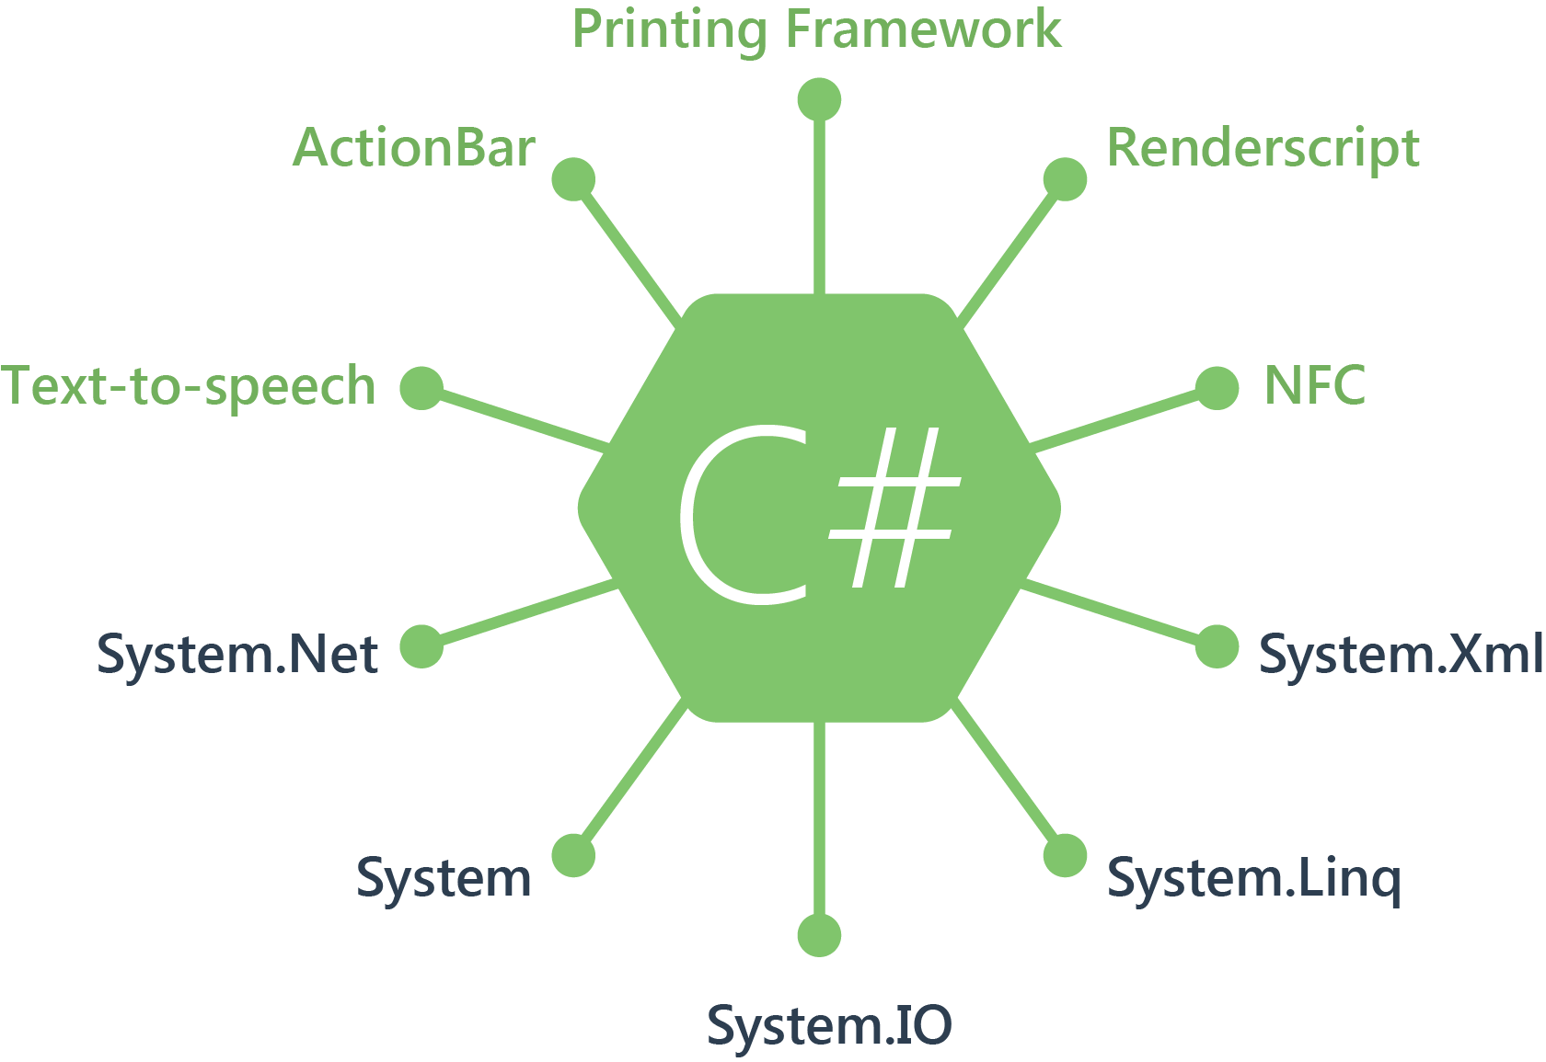
Xamarin for Android
Based on Mono for Android
Runs Mono VM on Linux kernel along with ART
SGen Garbage collector for C# objects
Notes:
Monotouch keeps its references with retains for automatic disposing from the auto refcounting

Slide 12
Android
public class MyActivity extends Activity {
@Override
public void onCreate(Bundle savedInstanceState) {
Button myBtn = (Button) this.findViewById( R.id.clickMe);
myBtn.setOnClickListener( new View.OnClickListener() {
@Override
public void onClick(View view) {
AlertDialog.Builder builder = new AlertDialog.Builder(MyActivity.this) ;
builder.setTitle( "Hello World")
.setMessage("How are you?")
.setPositiveButton( "OK", new DialogInterface.OnClickListener() {
@Override
public void onClick(DialogInterface dialogInterface, int i) {
dialogInterface.dismiss();
}}) .show();
}}); }
}
[Activity (Label = "AndroidApp", MainLauncher = true, Icon = "@drawable/icon")] public class MainActivity : Activity { protected override void OnCreate (Bundle bundle) { base.OnCreate (bundle); SetContentView (Resource.Layout.Main); Button button = FindViewById<Button> (Resource.Id.me); button.Click += delegate { AlertDialog.Builder builder = new AlertDialog.Builder (this ); AlertDialog dialog = null ; builder.SetTitle ( "Hello World") .SetMessage ( "How are you") .SetPositiveButton( "OK" , delegate { dialog.Dismiss(); } ); dialog = builder.Show (); } ; } }

Slide 13
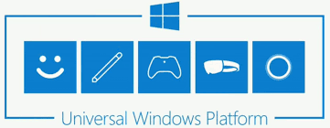
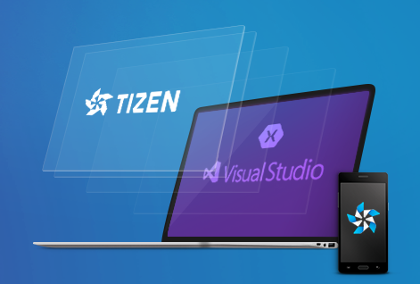

Others platforms
UWP – runs directly on .NET Core framework
https://docs.microsoft.com/en-us/windows/uwp/get-started/whats-a-uwp
.NET for Tizen – .NET Core port
developer.tizen.org
Xamarin.MAC – mono runtime running along Obj-C
https://developer.xamarin.com/guides/mac/
Notes:
Monotouch keeps its references with retains for automatic disposing from the auto refcounting

Slide 14
Demo:
Xamarin Forms app anatomy

Slide 15
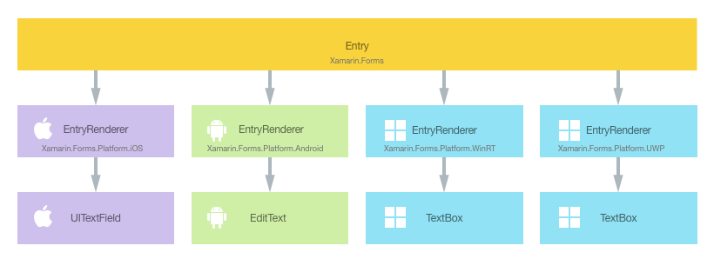
Xamarin Forms – under the hood
Xamarin Forms unify the UI into one API

Slide 16
Xamarin Forms – Renderers
public class EntryRenderer : ViewRenderer<Entry, EntryEditText>
{
protected override void OnElementChanged(ElementChangedEventArgs<Entry> e)
{
if (e.OldElement == null)
{
this._textView = this.CreateNativeControl();
}
}
protected override void OnElementPropertyChanged(object sender, PropertyChangedEventArgs e)
{
if (e.get_PropertyName() == Entry.TextProperty.PropertyName)
{
if (base.Control.get_Text() != base.Element.Text)
{
base.Control.set_Text(base.Element.Text);
if (base.Control.get_IsFocused())
{
base.Control.SetSelection(base.Control.get_Text().get_Length());
base.Control.ShowKeyboard();
}
}
}
base.OnElementPropertyChanged(sender, e);
}

Slide 17
Xamarin Forms – Effects
[assembly:ExportEffect (typeof(FocusEffect), "FocusEffect")]
namespace EffectsDemo.iOS
{
public class FocusEffect : PlatformEffect
{
...
protected override void OnElementPropertyChanged(PropertyChangedEventArgs args)
{
base.OnElementPropertyChanged(args);
if (args.PropertyName == "IsFocused")
{
if (Control.BackgroundColor == backgroundColor)
{
Control.BackgroundColor = UIColor.White;
}
else
{
Control.BackgroundColor = backgroundColor;
}
}
}
}

Slide 18
Xamarin Forms – Effects
Consuming the effect
<Entry Text="Effect attached to an Entry">
<Entry.Effects>
<local:FocusEffect />
</Entry.Effects>
...
</Entry>

Slide 19
Xamarin Forms – mixing platform code
OnPlatform
<Label Text="Text" >
<Label.FontSize>
<OnPlatform x:TypeArguments="x:Double"
iOS="20"
Android="22" />
</Label.FontSize>
</Label>

Slide 20
Xamarin Forms – mixing platform code
Conditional compilation
#if __ANDROID__
string libraryPath = Environment.GetFolderPath(Environment.SpecialFolder.Personal);
#elif __IOS__
string documentsPath = Environment.GetFolderPath (Environment.SpecialFolder.Personal);
string libraryPath = Path.Combine (documentsPath, "..", "Library");
#else
string libraryPath = Windows.Storage.ApplicationData.Current.LocalFolder.Path;
#endif

Slide 21
Xamarin Forms – mixing platform code
<?xml version="1.0" encoding="utf-8"?>
<ContentPage xmlns="http://xamarin.com/schemas/2014/forms"
xmlns:x="http://schemas.microsoft.com/winfx/2009/xaml"
xmlns:ios="clr-namespace:UIKit;assembly=Xamarin.iOS;targetPlatform=iOS"
xmlns:androidWidget="clr-namespace:Android.Widget;assembly=Mono.Android;targetPlatform=Android"
xmlns:formsAndroid="clr-namespace:Xamarin.Forms;assembly=Xamarin.Forms.Platform.Android;targetPlatform=Android"
xmlns:win="clr-namespace:Windows.UI.Xaml.Controls;assembly=Windows, Version=255.255.255.255, Culture=neutral, PublicKeyToken=null, ContentType=WindowsRuntime;targetPlatform=Windows"
x:Class="NativeViewDeclaration.NativeViewDeclarationPage">
<ContentPage.Content>
<ios:UISwitch OnTintColor="{x:Static ios:UIColor.Red}"/>
<androidWidget:Switch x:Arguments="{x:Static formsAndroid:Forms.Context}" Text="Enable Entry?" />
<win:ToggleSwitch Header="Enable Entry?" OffContent="No" OnContent="Yes />
</ContentPage.Content>
</ContentPage>

Slide 22
Demo:
Mixing platform code

Slide 23
Xamarin Forms – embedding Forms
Android
// #1 Initialize
Forms.Init(this, null);
// #2 Use it
_history = new HistoryPage().CreateFragment(this);
IOS
// #1 Initialize
Forms.Init();
...
// #2 Use it
_historyViewController = new HistoryPage().CreateViewController();

Slide 24
Xamarin Forms – embedding Forms (2)
UWP
// #1 Initialize
Forms.Init();
...
// #2 Use it
var content = new HistoryPage().CreateFrameworkElement();

Slide 25
Demo:
Embedding Forms

Slide 26
Xamarin Forms – Live player (Preview)
Boost Xaml views development tenfold
Runs on Android and IOS
Can run on IOS device without compiling your code on Mac!
Still has a lot of limitations

Slide 27
Demo:
Live Player (Preview) == might break

Slide 28
Fast Renderers
Default renderer
public class ButtonRenderer : ViewRenderer<Button, AButton>, AView.IOnAttachStateChangeListener
Fast renderer
internal sealed class ButtonRenderer : AppCompatButton, IVisualElementRenderer, AView.IOnAttachStateChangeListener, AView.IOnFocusChangeListener, IEffectControlProvider, AView.IOnClickListener, AView.IOnTouchListener

Slide 29
What’s coming
Improved Design experience
XAML Standard 1.0
https://github.com/Microsoft/xaml-standard
Xamarin Forms 3.0
Layout Compression
Performance optimizations
XF for Linux
https://blog.xamarin.com/glimpse-future-xamarin-forms-3-0/

Slide 30
Thank you!
@tsvyatco
tsvyatko@konov.me

Slide 31
Useful resources
https://developer.xamarin.com/guides/xamarin-forms/creating-mobile-apps-xamarin-forms/
iOS Programming: The Big Nerd Ranch Guide
Android Programming: The Big Nerd Ranch Guide
https://channel9.msdn.com/Events/Build/2017/B8099

Slide 32
Sources
https://github.com/davidortinau/build2017-new-in-xamarin-forms
https://developer.xamarin.com/samples/xamarin-forms/UserInterface/CustomLayout/WrapLayout/

Slide 33
.NET

